Slide 1
Welcome to Hello World Series
What is a GIT Client

Slide 2
Problem statement
I am a command lover and don’t like much of GUI.
I want to do all Git operations on my local machine using commands first and then GUI.

Slide 3
In last tutorial...
We discussed – How to connect to GitHub server i.e. GIT Clients

Slide 4




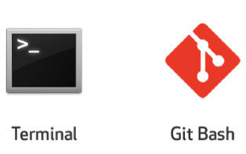
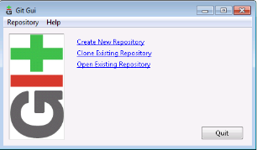

In this tutorial...
We will see, How to install commands/GUI based GIT client i.e. GIT Bash and GIT GUI.
GIT Servers
GIT Clients

Slide 5
Download git bash and git GUI

Slide 6
Install GIT Bash and GIT GUI

Slide 7
Verify Installation

Slide 8
Launch GIT Bash and GIT GUI

Slide 9
Coming up Next
Tortoise GIT client installation
Notes:
In Slide Show mode, click the arrow to enter the PowerPoint Getting Started Center.

